Slide 1


INSTITUTE : UIE
DEPARTMENT : CSE
Bachelor of Engineering (Computer Science & Engineering)
WEB AND MOBILE SECURITY (Professional Elective-I)
(20CST/IT-333)
TOPIC OF PRESENTATION:
SQL injection
DISCOVER . LEARN . EMPOWER

Slide 2
Lecture Objectives
In this lecture, we will discuss:
Introduction to cross-site scripting, SQL injection

Slide 3

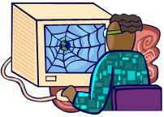

user connects to evil site
javascript executes as if
from bank; tokens stolen
Link to bank with malicious
javascript given as parameter
malicious javascript
reflected back to user with bank’s security context
Typically called
“reflected” XSS

Slide 4
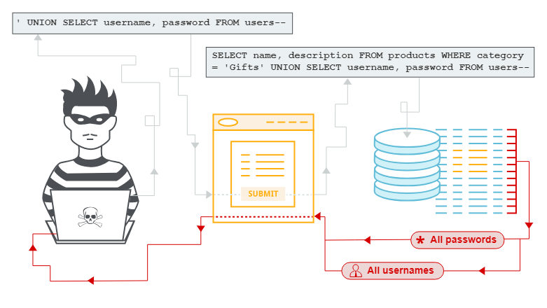
SQL injection

Slide 5
SQL injection (SQLi)
SQL injection (SQLi) is a web security vulnerability that allows an attacker to interfere with the queries that an application makes to its database. It generally allows an attacker to view data that they are not normally able to retrieve. In many cases, an attacker can modify or delete this data, causing persistent changes to the application's content or behavior.
In some situations, an attacker can escalate an SQL injection attack to compromise the underlying server or other back-end infrastructure, or perform a denial-of-service attack. Some common SQL injection examples include:
Retrieving hidden data, where you can modify an SQL query to return additional results.
Subverting application logic, where you can change a query to interfere with the application's logic.
UNION attacks, where you can retrieve data from different database tables.
Examining the database, where you can extract information about the version and structure of the database.
Blind SQL injection, where the results of a query you control are not returned in the application's responses.
Retrieving hidden data.

Slide 6
Impact
Therefore, a successful SQL Injection attack can have very serious consequences.
Attackers can use SQL Injections to find the credentials of other users in the database. They can then impersonate these users. The impersonated user may be a database administrator with all database privileges.
SQL lets you select and output data from the database. An SQL Injection vulnerability could allow the attacker to gain complete access to all data in a database server.
SQL also lets you alter data in a database and add new data. For example, in a financial application, an attacker could use SQL Injection to alter balances, void transactions, or transfer money to their account.
You can use SQL to delete records from a database, even drop tables. Even if the administrator makes database backups, deletion of data could affect application availability until the database is restored. Also, backups may not cover the most recent data.

Slide 7
How to Prevent SQL Injection Attacks?
Continuous Scanning and Penetration Testing
The automated web application scanner has been the best choice to point out vulnerabilities within the web applications for quite some time now. Now, with SQL injections getting smarter in exploiting logical flaws, website security professionals should explore manual testing with the help of a security vendor.
They can authenticate user inputs against a set of rules for syntax, type, and length. It helps to audit application vulnerabilities discreetly so that you can patch the code before hackers exploit it to their advantage.
2. Restrict Privileges
It is more of a database management function, but enforcing specific privileges to specific accounts helps prevent blind SQL injection attacks. Begin with no privileges account and move on to ‘read-only’, ‘edit’, ‘delete’ and similar privilege levels.
Minimizing privileges to the application will ensure that the attacker, who gets into the database through the application, cannot make unauthorized use of specific data.

Slide 8
3. Use Query Parameters
Dynamic queries create a lot of troubles for security professionals. They have to deal with variable vulnerabilities in each application, which only gets graver with updates and changes. It is recommended that you prepare parameterized queries.
These queries are simple, easy to write, and only pass when each parameter in SQL code is clearly defined. This way, your info is supplied with weapons to differentiate between code and information inputs.
4. Instant Protection
A majority of organizations fail the problems like outdated code, scarcity of resources to test and make changes, no knowledge of application security, and frequent updates in the application. For these, web application protection is the best solution.
A managed web application firewall can be deployed for immediate mitigation of such attacks. It contains custom policies to block any suspicious input and deny information breach instantly. This way, you do not have to manually look for loopholes and mend problems afterward.

Slide 9
References:
Books:
Web Design With HTML, CSS, JavaScript and jQuery Set, 1st Edition, by Jon Duckett.
Hacking Exposed Web Applications, 3rd edition, Joel Scambray, Vincent Liu, Caleb Sima, Released October 2010, Publisher(s): McGraw-Hill
Video Lectures :
https://www.youtube.com/watch?v=KUPlmDSDZLc
https://www.youtube.com/watch?v=NQ_WIyu9fUQ&t=868s
Reference Links:
https://portswigger.net/web-security/sql-injection
https://www.imperva.com/learn/application-security/sql-injection-sqli/
https://owasp.org/www-community/attacks/xss/
https://www.acunetix.com/websitesecurity/cross-site-scripting/

Slide 10

THANK YOU

